Slide 1
Predictive Parsers
Dr G Sudha Sadasivam

Slide 2
Agenda
FIRST
FOLLOW
PARSE TABLE CONSTRUCTION
PARSING ACTION
EXAMPLE

Slide 3
Introduction
Table driven
No left recursion
Non-backtracking (left factoring)
Construction:
1. Eliminate left recursion from G
2. Left factor G
3. Construct parse table
Finding FIRST(RHS)
Finding FOLLOW(NT)
Rules to construct PT
Check if the input string is accepted by the parser

Slide 4
FIRST
For a string of grammar symbols α, FIRST(α) is the set of terminals that begin all possible strings derived from α
FIRST(E)=FIRST(T)=FIRST(F)={(,id}
FIRST (E’) ={+, Є}
FIST (T’)={*,ϵ}
E -> T E’
E’->🡪 +T E’ | Є
T -> F T’
T’ ->🡪 *FT’ | ϵ
F -> (E) | id

Slide 5
Algorithm
1. If X is a terminal, FIRST(X) = X. eg. FIRST(a) ={a}
2. Otherwise (X is a nonterminal),
1. If X -> ε is a production, add ε to FIRST(X)
2. If X -> Y1 … Yk is a production, then place a in FIRST(X) if for some i, a is in FIRST(Yi) and
Y1…Yi-1 =*> ε.
FIRST(X1…Xn) = FIRST(X1), if ε ∈ FIRST(X1), then add FIRST(X2), and so on…
Example A -> BCd; B-> b | Є ; C -> c| ϵ
FIRST (A) = FIRST(B)={ϵ,b}; find FIRST(C)={ϵ, c} then d
Ans = {b,c,d}

Slide 6
Find FIRST of S, A, B, C
S -> ACB | Cbb | Ba
A -> da | BC
B -> g | Є
C -> h | Є

Slide 7
FOLLOW
FOLLOW(A) for non terminal A is the set of terminals that can appear immediately to the right of A in some sentential form. If A can be the last symbol in a sentential form, then $ is also in FOLLOW(A).
Place $ in FOLLOW(S) (for S the start symbol)
FOLLOW(E) has $
2. If A -> α B β, then FIRST(β)-ε is placed in FOLLOW(B)
FOLLOW (T) = FIRST E’) – Є ={ +}
3. If there is a production A -> α B or
a production A -> α B β where β =*> ε, then
everything in FOLLOW(A) is in FOLLOW(B).
FOLLOW (E) is in FOLLOW(E’)
FOLLOW(E’) is in FOLLOW(T)
E -> T E’
E’-> +T E’ | Є
T ->🡪 F T’
T’ ->🡪 *FT’ | ϵ
F -> (E) | id

Slide 8
Follow Example
E -> T E’
E’-> +T E’ | Є
T -> F T’
T’ -> *FT’ | ϵ
F -> (E) | id
FIRST(E,T,F)={(,id}
FIRST (E’) ={+, Є}
FIRST (T’)={*,ϵ}
From E-> TE’
R1:FOLLOW(E) has $
R2:FOLLOW(T) has FIRST (E’) ie ‘+’
R3:As FIRST (E’) has ϵ, FOLLOW(E) is in FOLLOW(T)
R3:FOLLOW(E) is in FOLLOW(E’)
From E’->+TE’ | Є
FOLLOW(T) has first(E’)… same
From T->FT’
R2: FOLLOW(F) has FIRST(T’) = ‘*’
R3: As Є is in FIRST (T’), FOLLOW(T) is in FOLLOW(F)
R3: FOLLOW(T) is in FOLLOW(T’)
From T’->*FT’ | Є …. Follow(F) has FIRST(T’) …same
From F🡪-> (E) ..FOLLOW(E) has ‘)’
FOLLOW(E)={$, )}
FOLLOW (T)={+,$,)}
FOLLOW(E’)=($,)}
FOLLOW(T’)={+,$,)}
FOLLOW(F)={*,+,$,)}

Slide 9
Parse Table Construction
Basic idea: if A -> α and a is in FIRST(α), then we expand A to α any time the current input is a and the top of stack is A.
Algorithm:
For each production A -> α in G, do:
For each terminal a in FIRST(α) add A -> α to M[A,a]
If ε ∈ FIRST(α), for each terminal b in FOLLOW(A), do:
add A -> α to M[A,b]
If ε ∈ FIRST(α) and $ is in FOLLOW(A), add A -> α to
M[A,$]
• Make each undefined entry in M[ ] an ERROR

Slide 10
Example
E -> TE’
E’ -> +TE’ | Ɛ
T -> FT’
T’ -> *FT’ | Ɛ
F -> (E) | id
First
Follow
F
T
E
E’
T’
{(,id}
{+, *, ), $}
{(,id}
{+, ), $}
{(,id}
{), $}
{+,ɛ}
{), $}
{*,ɛ}
{+, ), $}
Input Symbol
NT
id
+
*
(
)
$
E
E’
T
T’
F
E -> TE’
E -> TE’
E’ -> +TE’
E’ -> Ɛ
E’ -> Ɛ
T -> FT’
T -> FT’
T’ -> Ɛ
T’ -> *FT’
T’ -> Ɛ
T’ -> Ɛ
F -> id
F -> (E)

Slide 11
Parsing Action
The table is a 2D array M[A,a] where A is a non-terminal symbol and a is a terminal or $.
At each step, the parser considers the top-of-stack symbol X and input symbol a:
If both are $, accept
If they are the same (non-terminals), pop X, advance input
If X is a nonterminal, consult M[X,a].
If M[X,a] is “ERROR” call an error recovery routine.
Otherwise, if M[X,a] is a production of the grammar X -> UVW, replace X on the stack with WVU (U on top)

Slide 12
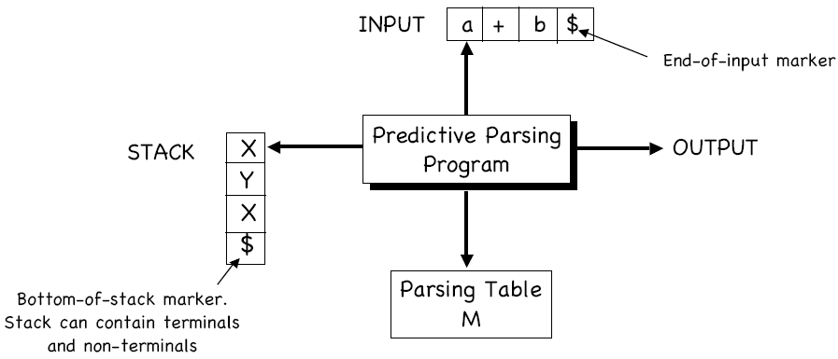

Slide 13
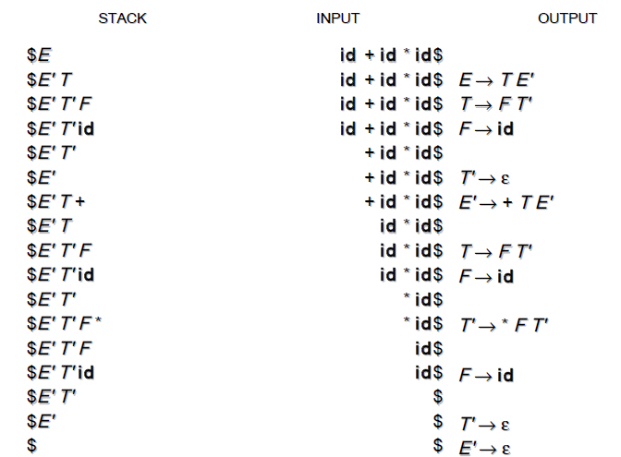
Initial stack is $E Initial input is id + id * id $

Slide 14
Construct Predictive Parse Table
S -> a | - | (T)
T -> T,S | S
Show parsing actions for (a,a)

